Slide 1
Booklobe: A Visual Journey Through the Online Book Library
Presented BY:
Revanth Atluri (21BCE5408)

Slide 2

Introducing Booklobe: The Ultimate Online Book Library
Why Choose Booklobe?
User Friendly feature of booklobe
Unlimited Access to Books
Personalized Recommendations
Join the Booklobe Community

Slide 3

Introducing Booklobe: The Ultimate Online Book Library
Welcome to Booklobe, the ultimate online book library. We are thrilled to introduce you to our platform, which is designed to provide book lovers with an unparalleled reading experience.
At Booklobe, we believe that reading should be a seamless and enjoyable experience. That's why we have created an online library that is user-friendly, easy to navigate, and packed with features that will enhance your reading journey. Whether you're a casual reader or a book enthusiast, Booklobe has something for everyone

Slide 4

Why Choose Booklobe?
Booklobe offers a personalized experience for every user. Our recommendation system uses artificial intelligence to suggest books based on your reading history and preferences. This means that you are more likely to find books that you will enjoy, without having to spend hours searching through our vast collection.
In addition to personalized recommendations, Booklobe also offers unlimited access to books. You can read as many books as you want, whenever you want, without any restrictions. And with our user-friendly interface, finding and reading books has never been easier

Slide 5

Simplicity is Key
At Booklobe, we understand that reading should be a relaxing and enjoyable experience. That's why we've designed our platform with simplicity in mind. Our user-friendly interface makes it easy to search for books, create reading lists, and manage your account. You can even customize your reading experience by adjusting font sizes and background colors!
Navigating through our vast collection of books has never been easier. With just a few clicks, you can find the book you're looking for and start reading right away. No complicated menus or confusing layouts. Just simple, intuitive design that puts the focus on what matters most - the books themselve

Slide 6

Unlimited Access to Books
Book lovers rejoice! With Booklobe, you have unlimited access to an extensive collection of books from various genres. From classic literature to modern-day bestsellers, Booklobe has it all. No more waiting in line or searching through multiple libraries - all the books you need are just a click away.
But that's not all - Booklobe also offers the convenience of having access to all your favorite books in one place. Whether you're at home, at work, or on-the-go, you can easily browse and read books on any device. Say goodbye to lugging around heavy books or worrying about due dates - with Booklobe, you have complete control over your reading experience.

Slide 7

Join the Booklobe Community
By signing up for Booklobe, you'll not only have access to an incredible selection of books, but you'll also become a part of a community of book lovers from all over the world. Share your thoughts on your favorite books, discover new authors, and connect with like-minded individuals who share your passion for reading.
As a member of the Booklobe community, you'll have the opportunity to participate in book clubs, attend virtual author events, and engage in lively discussions about your favorite books. You'll also receive personalized recommendations based on your reading history and preferences, ensuring that you never run out of great books to read

Slide 8
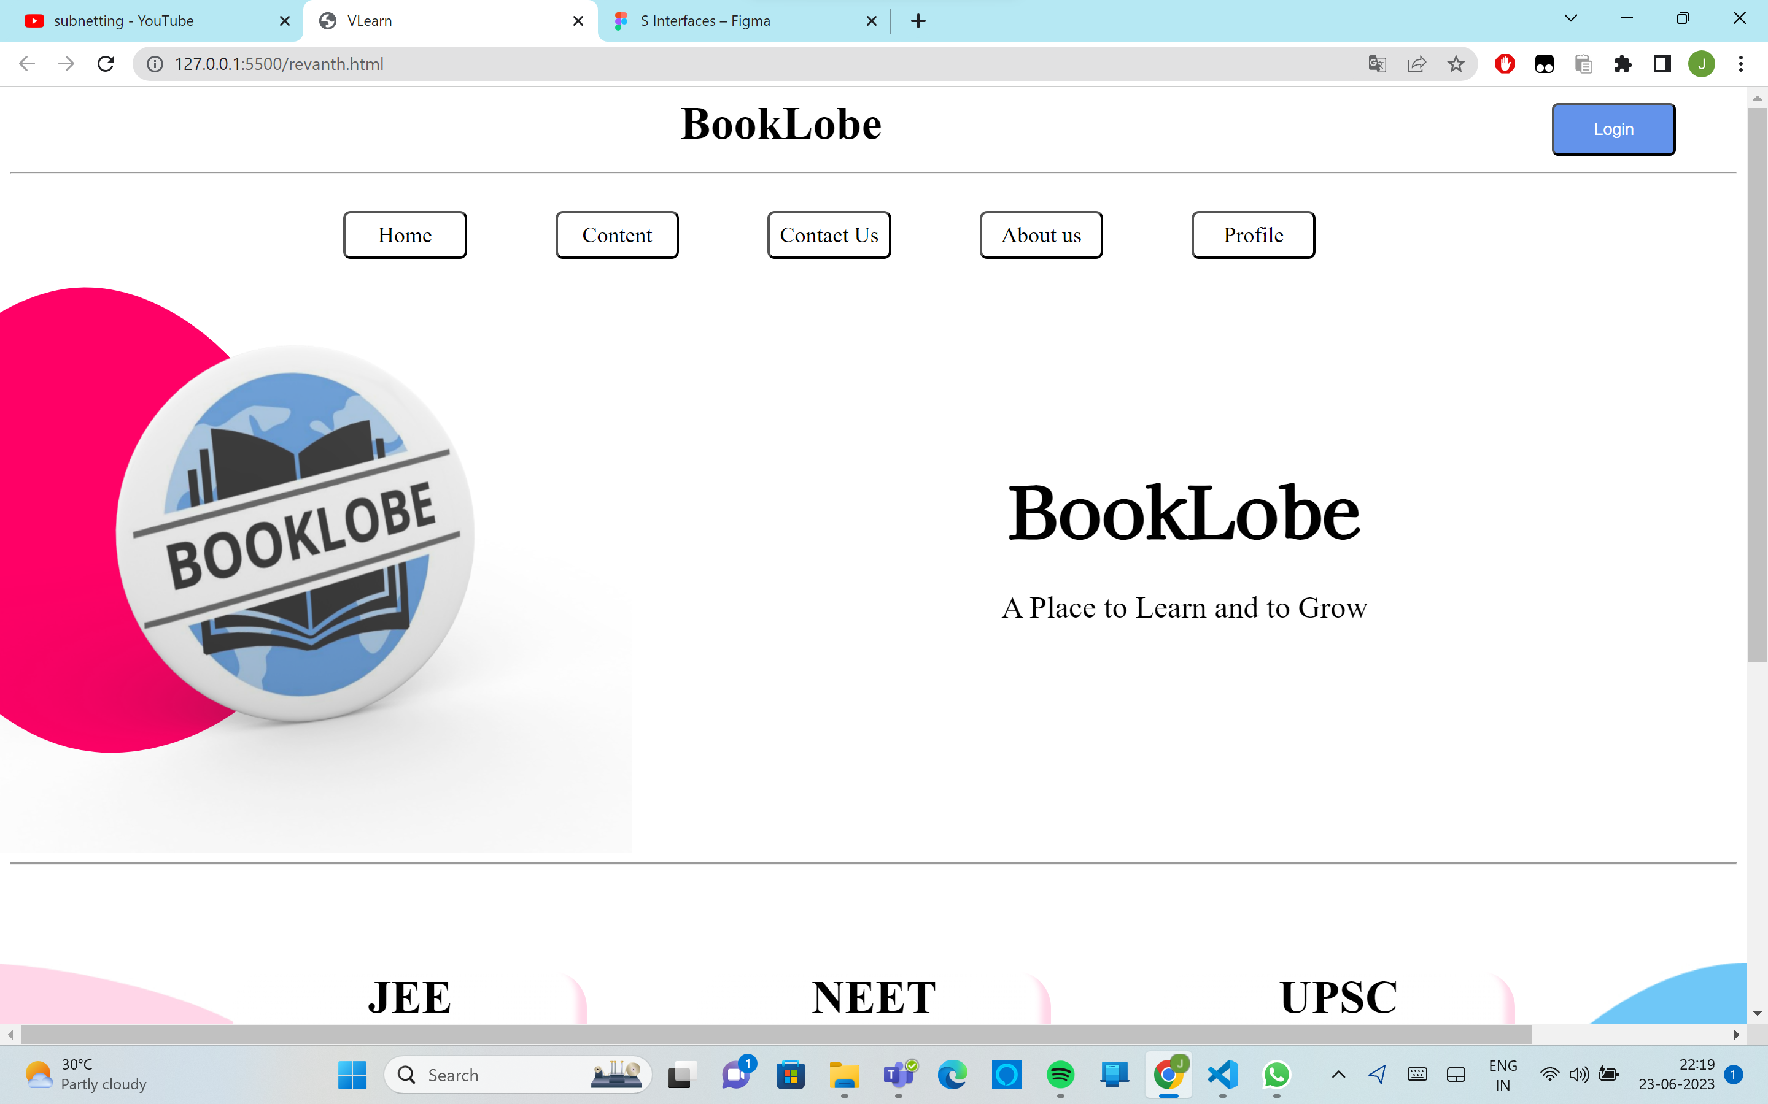
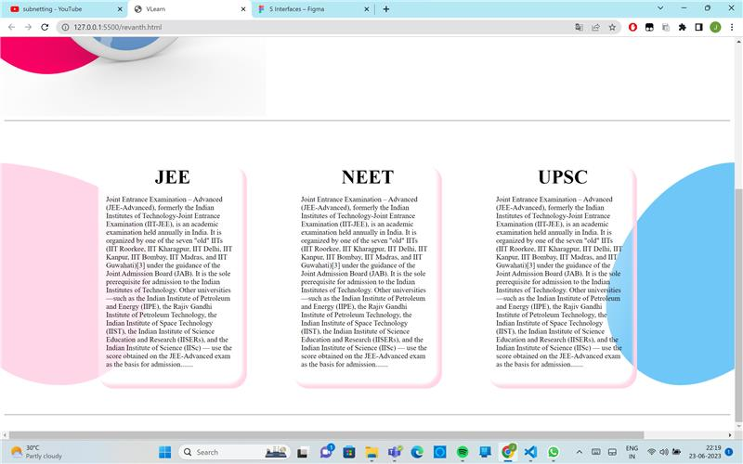
Correct Stance of the Project

Slide 9
